Slide 1
SDLC Spiral Model
Raghul S M – Impact Training

Slide 2
Introduction
The Spiral Model in the Software Development Life Cycle (SDLC) is a risk-driven, iterative process model that combines the features of both the Waterfall Model and Prototyping Model. It emphasizes constant refinement through repeated iterations (or "spirals") and focuses on risk assessment and management. The model is best suited for large, complex, and high-risk projects where requirements are not fully understood upfront or may evolve over time.

Slide 3
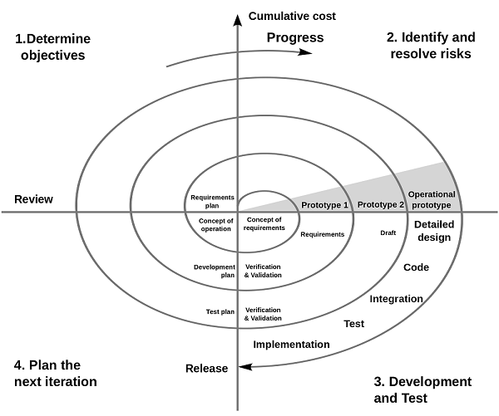
Spiral Model

Slide 4
Planning Phase
Objective Setting: The first step in each spiral is to define the objectives of the current iteration. This includes understanding the requirements and goals of the project.
Risk Identification: At this stage, the project team identifies potential risks that may affect the project. These could include technical risks, scheduling risks, or resource-related risks.
Alternatives Consideration: Different ways to achieve the objectives are explored. This phase involves brainstorming possible approaches or solutions for the identified objectives.
Constraints Identification: Any constraints, such as budget, time, technology, or resources, that may affect the design or implementation are outlined.

Slide 5
Risk Analysis and Evaluation
This phase involves analyzing the potential risks identified in the previous phase. The goal is to assess how severe these risks are and how they could impact the project's success.
Different strategies to mitigate or resolve risks are developed. This could involve prototyping, testing concepts, or designing alternative approaches.
The team evaluates the alternatives, weighs the risk factors, and determines which approach will be the most viable in terms of cost, feasibility, and time constraints.

Slide 6
Engineering Phase
Based on the decisions made in the risk analysis and evaluation phase, the actual development of the product or system begins. This phase includes:
Designing the system or software.
Coding and implementation of features.
Prototyping (if necessary) to clarify requirements and improve understanding.
Testing the developed product to ensure it meets the design specifications.
After each iteration, a working version of the software is produced, even if it is not fully complete. This incremental approach helps identify and correct problems early in the project.

Slide 7
Evaluation Phase (Customer Feedback and Planning for Next Iteration)
After each iteration or cycle, customer feedback is gathered to assess whether the current design and progress align with expectations.
The product’s progress and performance are evaluated, and the feedback helps in refining the requirements for the next phase of development.
Based on the feedback, decisions are made on whether to continue, revise, or stop the project.
The next spiral iteration is planned, and the objectives, risks, and deliverables for the upcoming cycle are defined.

Slide 8
Iteration (Repeat Steps for Future Phases)
Once one cycle is completed, the process starts again with new or modified objectives based on the lessons learned from the previous spiral.
The Spiral Model is repeated in successive cycles until the software product is fully developed and ready for deployment.
Each iteration produces a refined version of the product, with continuous risk assessment and management.
The model allows for flexibility in accommodating changing requirements throughout the project's life cycle.

Slide 9
Benefits of the Spiral Model
Risk Management: The focus on risk assessment helps to avoid potential project failures by addressing issues early.
Customer Involvement: Continuous customer feedback throughout each iteration ensures the product meets the customer's needs.
Flexibility: It allows for flexibility and adaptation to changes in requirements during the development process.
Improved Quality: Iterative development with regular testing and prototyping ensures higher quality in the final product.

Slide 10
Disadvantages of the Spiral Model
Complexity: The model can be difficult to manage, especially for smaller projects, due to its repetitive and detailed nature.
Resource Intensive: Because of the continuous risk analysis, prototyping, and testing, it can require more time and resources.
Costly: The ongoing refinement and multiple iterations can increase the overall cost of the project.

